Slide 1

Mini Project-I (K24MCA18P) Odd Semester Session 2024-25
MINDFUL MOMENTS
Team Leader -Suchita Singh(2426mca2494)
Team Member- Shweta Patel (2426mca709 )
Project Supervisor:
Ms. Divya Singhal
Assistant Professor

Slide 2
Content
Introduction
Literature Review
Objective of the Project
Technology
Hardware Requirements
Software Requirements
Workflow
Reports
References
Notes:
Font Styles: Times New Roman + Font Size: 25

Slide 3

Introduction
Mindful Moments: A Mindful Living Website
Mindful Moments is a website designed to help individuals cultivate mindfulness in their daily lives. It offers a variety of resources, including guided meditations, articles, and tips, to promote a sense of calm and well-being.

Slide 4

Literature Review
1
Mindfulness Research
2
Mindful Living Websites
The literature review explored various research studies and findings on the benefits of mindfulness practices.
An analysis of existing mindful living websites was conducted to identify best practices and user experience strategies.
3
User Needs & Preferences
The research aimed to understand the target audience's needs, preferences, and expectations for a mindful living website.

Slide 5
Objective of the Project
Promote Mindfulness:-To provide accessible resources for individuals seeking to integrate mindfulness into their lives.
Enhance Well-being:-To support users in cultivating a greater sense of calm, focus, and emotional well-being.
Improve User Experience:-To create a user-friendly website that offers a positive and engaging experience.

Slide 6
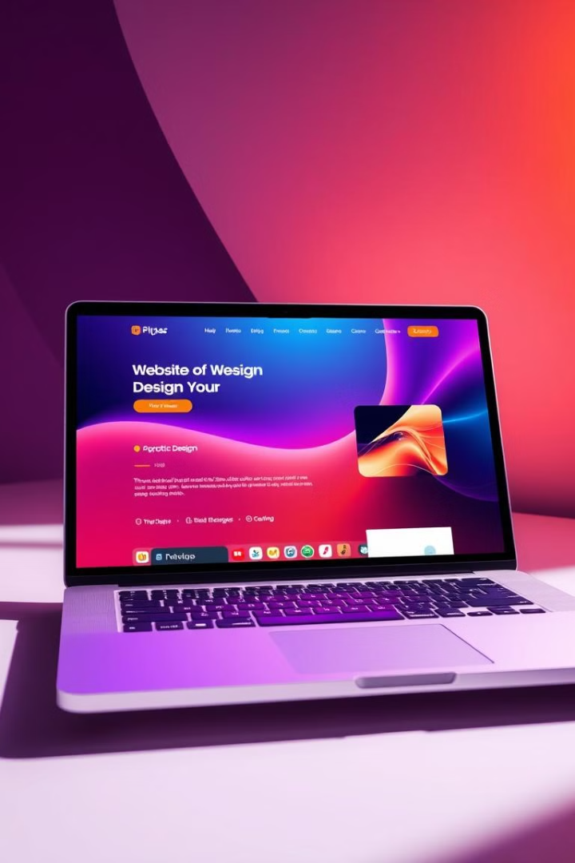
Technology
Hardware
Software
Personal Computer (PC) or Laptop
To include the frontend framework
(HTML, CSS, JavaScript)
Sufficient storage and memory
Vs code platform
Web Browser (e.g., Chrome, Firefox)
Programming Languages (e.g., HTML, CSS, JavaScript,)

Slide 7
Modules
Homepage :
Introduction to the website, with a brief overview of its purpose, features, and benefits.
Meditation Library :
A collection of guided meditations on various topics, including stress reduction, sleep improvement, and self-compassion.
Mindfulness Articles
:
Articles, blog posts, and other content providing information and insights on mindful living practices.

Slide 8
In this we will provide the user with different kind of activities related to their problem.
Mindfulness Activities
:
Feedback by user
User can provide with the content or any other features they want and can share their experiences .
:
User Authentication :
(Login/Signup) and feedback storage in the backend.

Slide 9
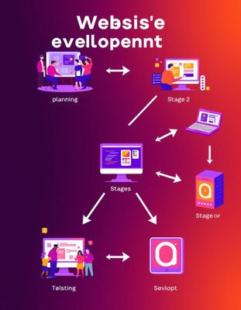




Workflow
Planning & Design(1-2weeks)
Defining the website's purpose, target audience, and features.
Development (3-7 weeks)
Coding the website using HTML, CSS, and JavaScript.
Testing & Deployment (8-9 weeks)
Ensuring the website functions correctly and is optimized for user experience.
Maintenance & Updates (10-11weeks)
Regularly updating content, fixing bugs, and improving performance.

Slide 10
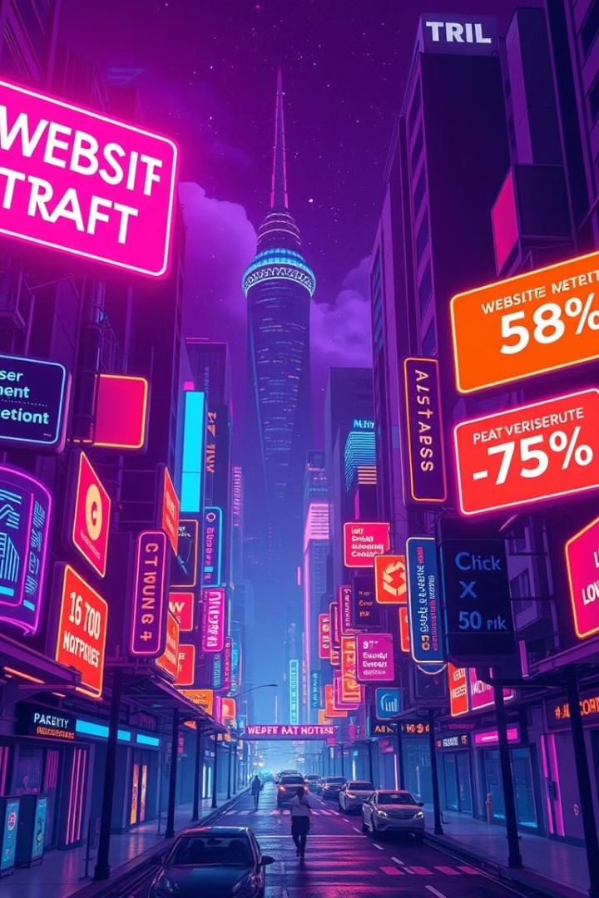
Reports
Website Traffic
Track the number of visitors to the website and their behavior on the site.
User Engagement
Measure user interaction with the website's content, such as time spent on pages, clicks, and downloads.
User Feedback
Collect user feedback through surveys, comments, and contact forms to understand their experiences and identify areas for improvement.

Slide 11

References
References
Kabat-Zinn, J. (1990). Full Catastrophe Living: Using the Wisdom of Your Body and Mind to Face Stress, Pain, and Illness. Delta Publishing. This book introduces mindfulness-based stress reduction (MBSR) and provides foundational principles that could be applied in meditation apps.
Goleman, D. (2013). Focus: The Hidden Driver of Excellence. HarperCollins. Explores the science of mindfulness and focus, relevant to designing mindfulness-based platforms for improving cognitive performance.
W3Schools HTML, CSS, JavaScript Tutorials URL: https://www.w3schools.com/ A widely used online resource for quick reference and tutorials on web development languages. W3Schools is ideal for beginners looking to grasp the basics of HTML, CSS, and JavaScript.
YouTube Audio Library: URL: https://www.youtube.com/audiolibrary/music YouTube offers a free library of music tracks and sound effects that can be used in personal and commercial projects.

